Slide 1
Migration experiences

Slide 2
First of all
Stay positive
Different levels of technological literacy
It is our goal to help them migrate, not be the service desk

Slide 3
Mobile phone migrations
Private phone?
Company phone?
Samsung A34
Samsung A54

Slide 4
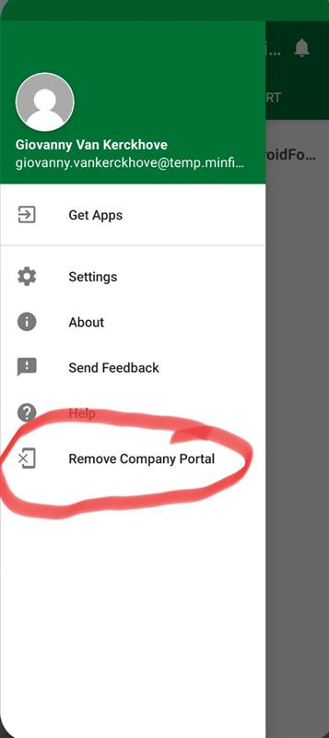
Private phone
Reset company portal
Follow instructions
! Use new account to login !

Slide 5
Company phone
2 models encountered
Samsung A54 => Full factory reset was the only option (At that time)
Samsung A34 => No possible way to transfer company portal at the time

Slide 6
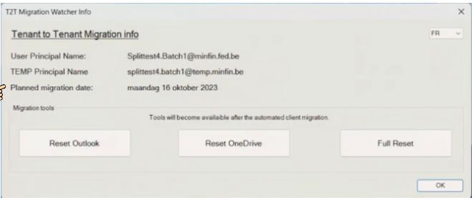
Computer migrations
Common checks
T2T watcher => If buttons are clickable, the migration has at least been started IF not wizard needs to appear
User needs to use temp account for teams and outlook
User still uses old account for Sharepoint

Slide 7
Edge cases
Migration wizard not appearing => Wait until 12h otherwise tell them to contact service desk
2 Onedrives (old MINFIN , new Onedrive) => Onedrives should clone themselves, we only work in the NEW Onedrive from now on!

Slide 8
Important
Temp mail => Permanent! Old mail will be deleted!
Old Onedrive will be deleted!
Mailboxes are migrated but Teams conv. are not (groups are being migrated)
*For now old mails can be used in teams, new Teams allows simultaneous access (2 channel communication!)

Slide 9
FIN
GOOD LUCK!

